Slide 2
ORDER TO CASH

Slide 3
End to end global sales process
Sales Order Management

Slide 4
Sales Order Process
O2C Master Data
Sales Document Management
Key
Key
Business Partners
Sales Order Management
Outbound Delivery Management
Material Master
Post Goods Issue Processing
Pricing Conditions
Billing Management
Accounts Receivable Processing
Customer Payment / Complaints

Slide 5
Sales Order Process Overview
Create Sales Order
Outbound Delivery
Post Goods Issue
Billing Management
Accounts Receivable
Customer Payment
The Create Sales Order process differs depending on the Sales Order Type selected.

Slide 6
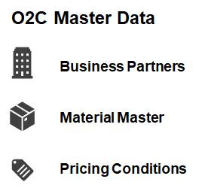
Sales Document Management
What is Sales Document Management?
Sales Document Management and processing allows users to execute business transactions based on Sales Documents, such as Inquiry, Quotation, and Sales Orders.
Users create Sales Documents based on the Customers requirements
When creating or changing Sales Documents, the system automatically confirms Delivery Dates and Quantities
Sales Documents can be displayed or changed according to Customer questions and requirements
Sales Document in SAP S/4 HANA
When entering Sales Documents the system automatically proposes data from Master Data:
From the Business Partner: Customer record the system proposes Sales, Shipping, Pricing, and Billing data
In addition, the system copies Business Partner: Customer specific data about Texts, Partners, and Contact people at the Customer site
From the Material Master, for each Material (Product) entered in the Sales Document, the system automatically proposes data from the relevant Material Master records, such as data for Pricing, Delivery Scheduling, Availability Check, Tax Determination, Weight and Volume

Slide 7
Sales Document Management: Sales Document Flow in Sales Documents
Sales Document Flow in Sales Documents
Sales Documents created are individual documents but they can also form part of a chain of inter-related Sales Documents.
Example
Sales Document Flow:
We record a Customer’s telephone Inquiry in the system
The Customer requests a Quotation, create with reference to the Inquiry
The Customer places an order on the basis of the Quotation, we create a Sales Order with reference to the Quotation
JTI then ship the goods and bills the Customer
After Delivery, the Customer claims Credit for some damaged goods, we then create a Credit Memo Request with reference to the original Sales Order
The entire chain of documents – the Inquiry, the Quotation, the Sales Order, the Delivery, the Invoice, and the subsequent Credit Memo Request – creates a Document Flow or history.
Sales Document Flow
Customer Inquiry
Customer Quotation
Sales Order
Outbound Delivery
Billing document (Invoice)
Credit Memo Request

Slide 8
Sales Organization structure
Click here to view the
Sales Organization Structure
training materials

Slide 9
Sales Organization Structure
Click here to view the Sales Organization Structure
training materials.
Sales Organizational Structure
SAP S/4 HANA Sales Organization structure is used to represent the legal and organizational structure of JTI.
For JTI, the Sales Organization structure is set up from the point of view of Accounting, Materials Management and Sales and Distribution.
It is possible to combine these structures.
The JTI Sales Organization Structure forms the framework in which sales business transactions can be processed.

Slide 10
Sales Organization Structure and Master Data in Sales
Create Sales Order
Outbound Delivery
Post Goods Issue
Billing Management
Accounts Receivable
Customer Payment
Sales Organization and Sales Order Master Data
Sales Organization Structure
Business Partner (BP): Customer
Material Master Data for Sales
Business Partner (BP): Customer Credit Management
Price Management / Price Determination

Slide 11
Sales Document Management: JTI Sales Organization Structure
JTI Sales Organizational Structure
The JTI Sales Organization Structure is made up of:
Sales Organization
Distribution Channel
Division
SAP S/4 HANA also uses other organizational units
Company Code (Finance)
Plant (Material Management)
Storage Location (Material Management)
Sales Organization Structure
Company Code
Sales Organization
Plant
Distribution Channel
Storage Location
Division
Sales Area

Slide 12
Sales Document Management: JTI Sales Organization Structure continued…
Sales Organization | Distribution Channel
A Sales Organization is responsible for the sale and distribution of goods and services. It represents the selling unit as a legal entity. Each business transaction is processed within a Sales Organization The Sales Organization must be specified in all sales documents. It is therefore available for all basic functions of O2C (such as pricing, availability, etc.). | The Distribution Channel represents the channel through which saleable materials or services reach customers. Distribution Channels include wholesale, retail and direct sales. Within a Sales Organization a Customer (BP) can be supplied through several Distribution Channels. In addition, the Material Master data relevant for sales, such as prices, minimum order quantity, minimum quantity to be delivered and delivering plant, can differ for each Sales Organization and Distribution Channel.
Division | Plant
In the SAP System you can define a division-specific sales organization. Product groups, i.e. Divisions, can be defined for a wide-ranging spectrum of products. For every Division you can make customer-specific agreements on, for example, partial deliveries, pricing and terms of payment. Within a Division you can carry out statistical analyses or set up separate marketing procedures | A Plant is a physical location of JTI, where the finished goods are stored for easy distributing the goods to customers.
Storage Location
The Storage Location is the sub-division of plant where the stocks are physically stored and maintained within a plant.
Each Storage Location can have its own address within a plant.

Slide 13
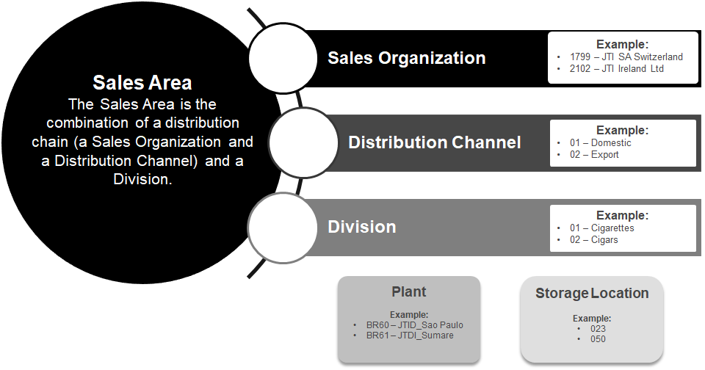
Sales Document Management: JTI Sales Organization Structure & Sales Area
JTI Sales Organization Structure
JTI Sales Area
Company Code
Sales Organization
Plant
Distribution Channel
Storage Location
Division
Sales Area

Slide 14
Business Partners (BP): Customers for Sales
Click here to view the
Business Partner (BP): Customer Overview training materials

Slide 15
Business Partner (BP): Customer for Sales
Create Sales Order
Outbound Delivery
Post Goods Issue
Billing Management
Accounts Receivable
Customer Payment
Sales Organization Structure and Sales Order Master Data
Sales Organization Structure
Business Partner (BP): Customer
Material Master Data for Sales
Business Partner (BP): Customer Credit Management
Price Management / Price Determination

Slide 16
Business Partners Overview
Click here to view the
Business Partner (BP): Customer Overview training materials.
Business Partner (BP) Definition:
A person, organization, group of people or group of organizations in which a company has business interest.
Business Partner (BP) Maintenance:
SDG - Supplier Data Governance is responsible for Vendor creation and maintenance using a modification tool that interfaces with SAP S/4 HANA.
SAP S/4 HANA:
Transaction Code BP, centrally manages Master Data for Business Partners in several roles, e.g.:
Vendors (3rd parties, intercompany and employees for expense reports)
Customers (3rd parties and intercompany)
Business Partners for treasury purposes (e.g. banks)

Slide 17
Business Partners Overview: BP Roles & Numbering
Business Partner (BP) Roles:
SAP provides a link between a business partner and other components by a role concept.
The role concept:
Defines the screen layout and which data fields to maintain
A business partner role is used to classify a business partner in business terms
The roles assigned to a business partner reflect the functions it has and the business transactions in which it is likely to be involved e.g., Purchasing, Sales, Treasury etc.
Role “General Business Partner” is always created
Other roles will be created according to the necessary functions for the Business Partner, examples:
ZD01SD: Domestic Customer SD
ZD01F1: Domestic Customer FI
UKM000: Credit Management Data
Business Partner: Customer Numbering
Listed Customer Account Groups number range is the same with Business Partner number range.
Code | Account Group | Number Range
ZCUS | JTI Customers | 0020000000 -0049999999
ZEXP | JTI Customer Export
INT | Intercompany (C.Code) | 000001000 - 000009999
ZICP | Intercompany (Plant) | A - ZZZZZZZZZZ
ZZLO | JTI Local Legal requirement | A - ZZZZZZZZZZ

Slide 18
Business Partners Overview: BP Roles & Numbering
Business Partner (BP) Roles:
SAP provides a link between a business partner and other components by a role concept.
The role concept:
Defines the screen layout and which data fields to maintain
A business partner role is used to classify a business partner in business terms
The roles assigned to a business partner reflect the functions it has and the business transactions in which it is likely to be involved e.g., Purchasing, Sales, Treasury etc.
Role “General Business Partner” is always created
Other roles will be created according to the necessary functions for the Business Partner, examples:
ZD01SD: Domestic Customer SD
ZD01F1: Domestic Customer FI
UKM000: Credit Management Data
Business Partner: Customer Numbering
Listed Customer Account Groups number range is the same with Business Partner number range.
Code | Account Group | Number Range
ZCUS | JTI Customers | 0020000000 -0049999999
ZEXP | JTI Customer Export
INT | Intercompany (C.Code) | 000001000 - 000009999
ZICP | Intercompany (Plant) | A - ZZZZZZZZZZ
ZZLO | JTI Local Legal requirement | A - ZZZZZZZZZZ

Slide 19
Business Partners Overview: Customer Partner Roles Overview
Sold-to Party:
The Sold-to Party is the Business Partner that orders the Sales Order and to whom Sales and Material Prices are recorded against.
Ship-to Party
Payer
Bill-to Party
Sold-to Party
Ship-to Party:
The Ship-to Party is the Business Partner address to where the Sales Order Materials are shipped.
The Sold-To Party is able to have many Ship-to Party (Delivery) addresses at different locations
Bill-to Party:
The Bill-to Party is the Business Partner address to where the Invoice is sent.
The Sold-to Party is able to have many Bill-to Party´s to reflect the Customers structure
Payer:
The Payer is the Business Partner address that will Pay the Invoice.
The Sold-to Party is able to have many Payer´s to reflect the Customers structure

Slide 20
Business Partners Overview: BP Customer Partner Roles in SAP S/4 HANA
Business Partner Roles for Domestic Customers
BP Code | BP Role Description | Account Group
ZD01SD | Domestic Sold-to Party SD | ZD01
ZD01FI | Domestic Sold-to Party FI
ZD02SD | Domestic Ship-to Party SD | ZD02
ZD02FI | Domestic Ship-to Party FI
ZD03SD | Domestic Payer SD | ZD03
ZD03FI | Domestic Payer FI
ZD04SD | Domestic Bill-to Party SD | ZD04
ZD04FI | Domestic Bill-to Party FI
ZPDOSD | Domestic Prospect SD | ZPD0
ZPDOFI | Domestic Prospect FI
Business Partner Roles for Export Customers
BP Code | BP Role Description | Account Group
ZE01SD | Export Sold-to Party SD | ZE01
ZE01FI | Export Sold-to Party FI
ZE02SD | Export Ship-to Party SD | ZE02
ZE02FI | Export Ship-to Party FI
ZE03SD | Export Payer SD | ZE03
ZE03FI | Export Payer FI
ZE04SD | Export Bill-to Party SD | ZE04
ZE04FI | Export Bill-to Party FI
ZE05SD | Intermediate Address | ZE05
ZPDOSD | Export Prospect SD | ZPEX
ZPDOFI | Export Prospect FI
Business Partner Roles for Others
BP Code | BP Role Description | Account Group
Z012SD | Hierarchy Node SD | Z012
Z012FI | Hierarchy Node FI
ZC01SD | JTI Contact Person SD | ZC01
ZC01FI | JTI Contact Person FI
ZCPDSD | One Time Customer SD | ZCPD
ZCPDFI | One Time Customer FI
ZZLOSD | Local Legal Req. SD | ZZLO
ZZLOFI | Local Legal Req. FI

Slide 21
Sales Document Management: Data from different Business Partners
Example Sales Order Business Partners:
This example shows the Sold-to Party, Ship-to Party, and Payer are all different and have different addresses:
In Sales Order Processing:
The Payment Terms are copied from the Payer
The Shipping (delivery) address is copied from the Ship-to Party.
Sales Document Data from different Business Partners
Sometimes the Business Partner: Customer master record specifies different Partners for the various Partner
Each Business Partner has its own Customer record. During Sales Document processing, the system automatically copies data from the Customer of the relevant Partner into the Sales Document.
Example:
A Customer may have several Ship-to Party´s for a single Sold-to Party and different Payers for receiving and paying invoices
Business Partner (BP)
Sold-to Party: Address - A
Pricing
Incoterms
Shipping Conditions
Ship-to Party: Address - B
Ship-to Address
Tax
Example:
For each different Ship-to Party, the system copies the appropriate Delivery and Shipping data from the Customer master record into the document
Payer:
Address - X
Term of Payment
Credit Limit Check

